Slide 1
AWS Basics

Slide 2
Amazon Web Services
Why Cloud Computing
Cloud Computing - Advantage
Cloud Computing Characteristics
Cloud Service Models
AWS Region & Availability Zone
AWS IAM
AWS IAM Features
AWS Athena Overview
AWS EMR Overview
AWS Glue Overview
2

Slide 3

Amazon Web Services
What is Cloud Computing
“Cloud computing is the on-demand delivery of compute power, database storage, applications, and other IT resources through a cloud services platform via the internet with pay-as-you-go pricing”
Simple way to Access IT resources over the Internet.
Cloud services provider owns and maintains the network-connected hardware required for these application services.
Access as many resources as you need, almost instantly, and only pay for what you use.
3

Slide 4
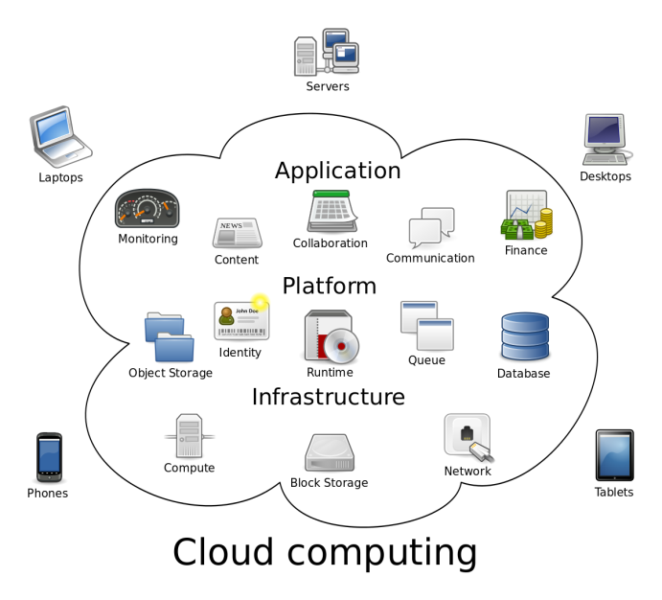

Cloud Computing - Advantages
Benefits of Cloud Computing
On Demand Service:- Cloud provides on demand services, that are always on, anywhere, anytime and any place.
Easy to Provision :- With few clicks provision the services
Elastic :- Scale up and down in capacity and functionalities, no need of guessing capacity
No Maintenance Cost - Managed services hence no cost maintaining hardware's, datacenters.
No Upfront Investment:- Pay only for the services that you use and for the duration you use.
4

Slide 5
Cloud Computing Characteristics
Common Characteristics:
Massive Scale
Resilient Computing
Elasticity
Geographic Distribution
Virtualization
Service Orientation
Low Cost Software
Advanced Security
Essential Characteristics:
On Demand Self-Service
Broad Network Access
Rapid Elasticity
Resource Pooling
Measured Service
5

Slide 6
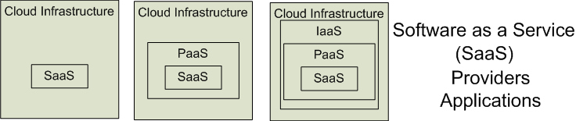

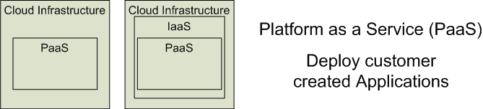

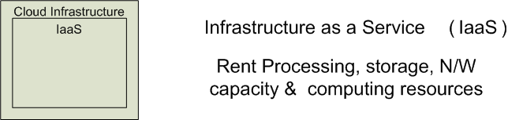

Cloud Service Models
Software as a Service (SaaS)
Platform as a Service (PaaS)
Infrastructure as a Service (IaaS)
Salesforce CRM
Web Mail
6

Slide 7
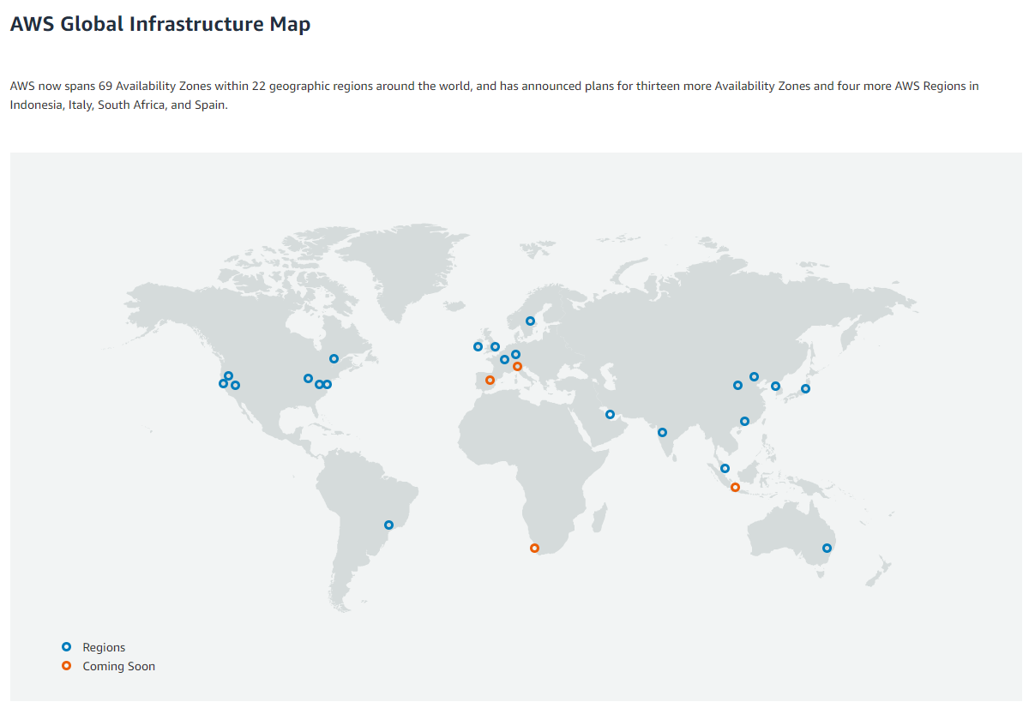
AWS Region & Availability Zone
Use the provided link for more details. https://aws.amazon.com/about-aws/global-infrastructure/regions_az/
7

Slide 8
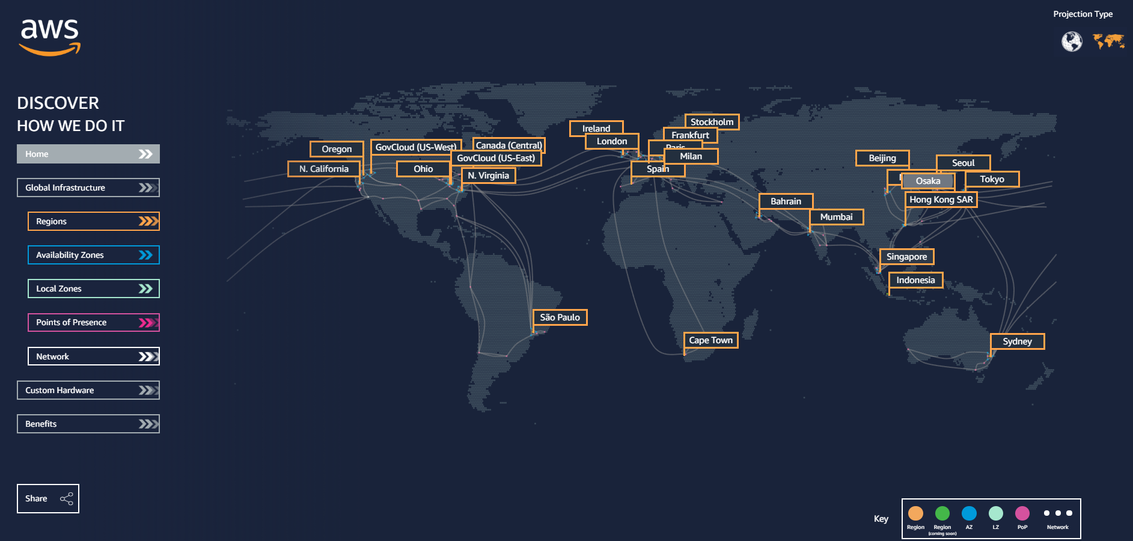
AWS Region & Availability Zone - Contd.
Use the provided link for more details. https://aws.amazon.com/about-aws/global-infrastructure/regions_az/
8

Slide 9
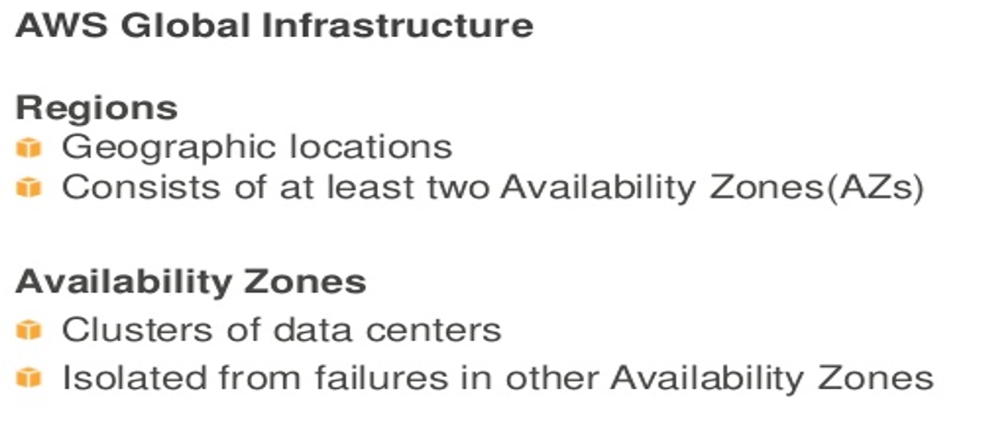
AWS Region & Availability Zone - Contd.
9

Slide 10
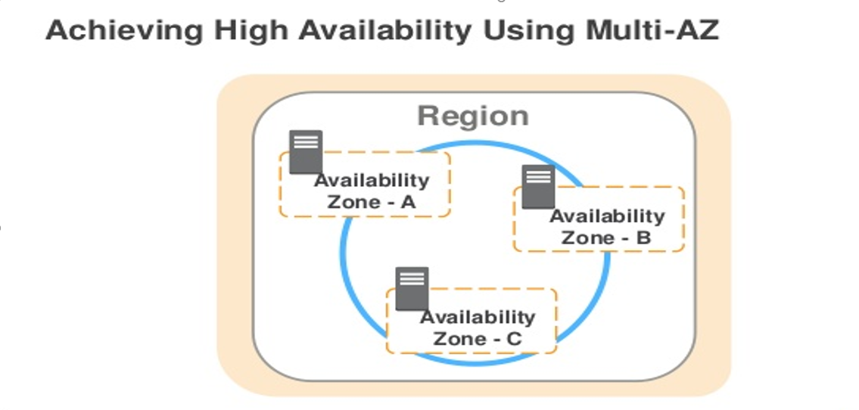
AWS Region & Availability Zone - Contd.
10

Slide 11
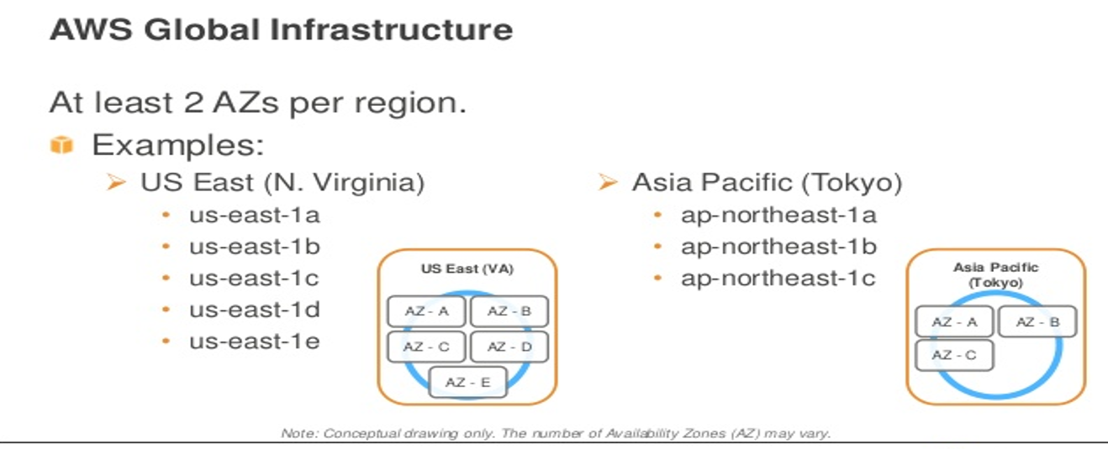
AWS Region & Availability Zone - Contd.
11

Slide 12

AWS IAM
AWS Identify and Access Management(IAM)
What is IAM
AWS IAM allows you to manage users and their level access to AWS services.
With AWS IAM you get to control who can do what in your AWS environment
It gives centralized control of your AWS Account and manage access/permissions of AWS Resources within it.
When you first create an AWS account, you begin with a single sign-in identity that has complete access to all AWS services and resources in the account. This identity is called the AWS account root user.
12

Slide 13
AWS IAM Features
What you can do with IAM
Shared Access to your AWS Account.
Root account in AWS IAM is the same as
Root in Windows/Linux.
Create users, groups and roles.
Granular permissions – control level of access of AWS Resources
Identify Federations (including Active directory, Facebook, LinkedIn, etc)
Multifactor Authentication
Password Rotation Policies
Manage Access Keys
Fine grained control of users, groups, roles, and permissions to resources
Offered at no extract charge.
13

Slide 14
AWS IAM Features - Contd.
IAM :- Access Control Mechanism
Users:- End users(Developers/Administrators , etc)
Groups:- A collections of users under one set of permissions
Roles :- You create roles and assign them to different AWS Resources
Policies:- A document that defined one or more Permissions. You attach policies to users, groups or roles.
Policies are stored in AWS as JSON documents
{
"Version": "2012-10-17",
"Statement": {
"Effect": "Allow",
"Action": "s3:ListBucket",
"Resource": "arn:aws:s3:::example_bucket“
}
}
14

Slide 15

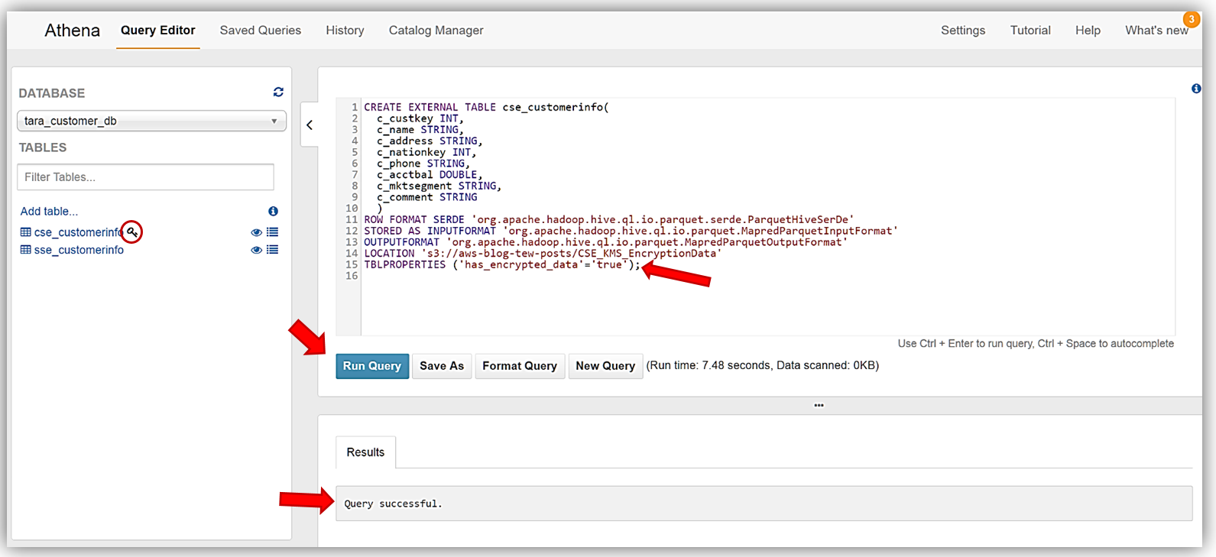
AWS Athena Overview
Amazon Athena is an interactive query service that makes it easy to analyze data directly in Amazon S3 using standard SQL. With a few actions in the AWS Management Console, you can point Athena at your data stored in Amazon S3 and begin using standard SQL to run ad-hoc queries and get results in seconds.
Athena is serverless, so there is no infrastructure to set up or manage, and you pay only for the queries you run.
Athena scales automatically—executing queries in parallel—so results are fast, even with large datasets and complex queries.
Athena helps you analyze various data formats like CSV, JSON, Apache Parquet and Apache ORC etc. You can use Athena to run ad-hoc queries using ANSI SQL, without the need to aggregate or load the data into Athena.
Use the provided link for more details. https://docs.aws.amazon.com/athena/latest/ug/what-is.htmlC
15

Slide 16

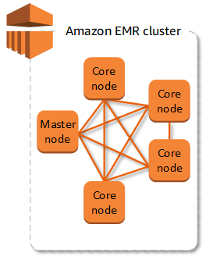
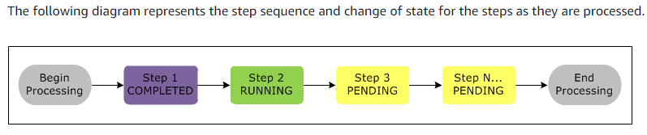
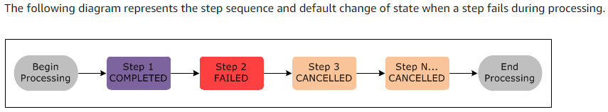
AWS EMR Overview
Amazon EMR is a managed cluster platform that simplifies running big data frameworks, such as Apache Hadoop and Apache Spark, on AWS to process and analyze vast amounts of data. By using these frameworks and related open-source projects, such as Apache Hive and Apache Pig, you can process data for analytics purposes and business intelligence workloads.
Additionally, you can use Amazon EMR to transform and move large amounts of data into and out of other AWS data stores and databases, such as Amazon S3 and Amazon DynamoDB.
The central component of Amazon EMR is the cluster. A cluster is a collection of Amazon EC2 instances. Each instance in the cluster is called a node.
The node types in Amazon EMR are Master node, Core node and Task node.
You can submit one or more ordered steps to an Amazon EMR cluster. Each step is a unit of work that contains instructions to manipulate data for processing by software installed on the cluster.
Use the provided link for more details. https://docs.aws.amazon.com/emr/latest/ManagementGuide/emr-what-is-emr.html
16

Slide 17

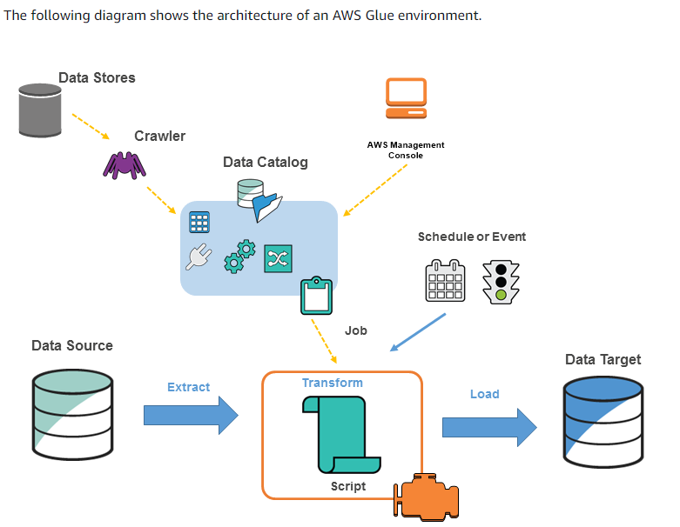
AWS Glue Overview
AWS Glue is a fully managed ETL (extract, transform, and load) service that makes it simple and cost-effective to categorize your data, clean it, enrich it, and move it reliably between various data stores.
AWS Glue consists of a central metadata repository known as the AWS Glue Data Catalog, an ETL engine that automatically generates Python or Scala code, and a flexible scheduler that handles dependency resolution, job monitoring, and retries.
AWS Glue is serverless, so there’s no infrastructure to set up or manage.
AWS Glue provides a console and API operations to set up and manage your extract, transform, and load (ETL) workload.
AWS Glue Components:
AWS Glue Console
AWS Glue Data Catalog
AWS Glue Crawlers and Classifiers
AWS Glue ETL Operations
The AWS Glue Jobs System
Use the provided link for more details. https://docs.aws.amazon.com/glue/latest/dg/what-is-glue.html
17
Use the provided link for more details. https://docs.aws.amazon.com/emr/latest/ManagementGuide/emr-what-is-emr.html

Slide 18
References
AWS : https://aws.amazon.com/
AWS Docs : https://docs.aws.amazon.com/index.html
AWS Glossary : https://docs.aws.amazon.com/general/latest/gr/glos-chap.html
18
Use the provided link for more details. https://docs.aws.amazon.com/emr/latest/ManagementGuide/emr-what-is-emr.html

Slide 19
Thank You

